Slide 1
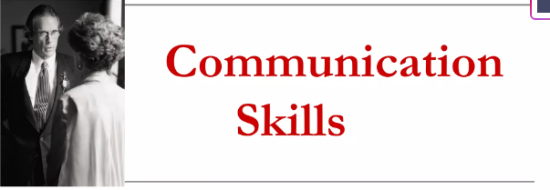
BBC-104

Slide 2
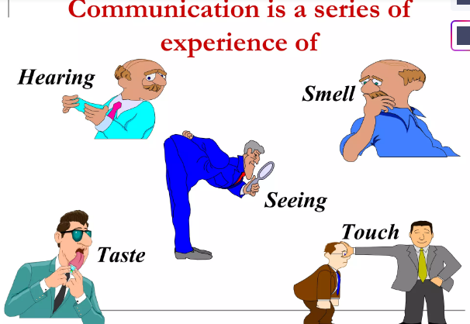

Slide 3
Communication skills are the abilities needed to effectively share information, ideas, and emotions through various means, including speaking, writing, listening, and observing. They are crucial for building strong relationships, achieving personal and professional goals, and navigating diverse social situations. Mastering these skills involves not only conveying messages clearly but also actively listening to and understanding others. Effective communication skills are crucial for success in all aspects of life, including personal relationships, academic achievement, and career advancement. They enable individuals to express themselves clearly, understand others, build strong relationships, and resolve conflicts. Strong communication also fosters confidence and enhances leadership potential.

Slide 4
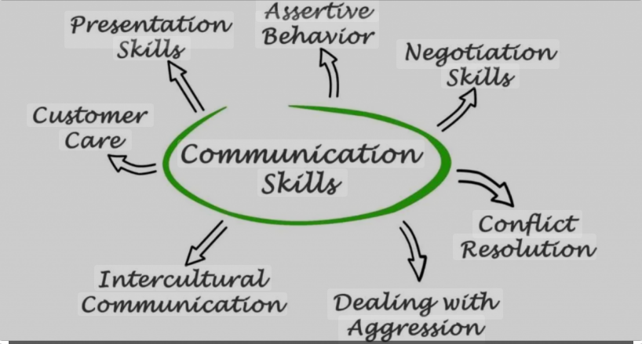

Slide 5
Origin and Scope
Its origin may be traced to the very origin of written communication
. With the development of plain English, Technical writing also came into existence
From the fourteenth century science has depended on technical communication to describe, disseminate , criticize ,use and improve innovations and advances in science, medicine and technology
technological developments were seen in the early writings and were transmitted to the generations orally, by examples and by apprenticeship
Notes:
Technical writing is professional writing. It is concerned with business –trade and commerce, medical, legal, and engineering profession. Technical writing comprises the official dispatches of business, administration and diplomacy. Technical writing is scientific by nature. As against the general writing, it is specialized writing. Broadly speaking all non-literary writing marked by simplicity, clarity and precision may be regarded as technical written communication. This may be called official communication as well. Its origin may be traced to the very origin of written communication. English is well suited for technical written communication because of its flexibility, precision and fluency as it is honoured with an international status today.
With the development of plain English, Technical writing also came into existence. From the fourteenth century on , the social system of science has depended on technical communication to describe, disseminate , criticize ,use and improve innovations and advances in science, medicine and technology. The recording of scientific observations and technological developments were seen in the early writings and were transmitted to the generations orally, by examples and by apprenticeship. Many astronomical observations were preserved in the writings of Egyptians, Chinese, Babylonians etc.Muhammad ibn Musa Al,Khowarizmi, a ninth century mathematician ,published a book about his approach and named his process the algorithm , a name that even today is used and employed in virtually all computer –programming languages today.In the 14th to 17th centuries an explosionof enquiry and inventiveness was seen in all fields of knowledge. A major diversion of the Renaissance from the previous history was to include science in the activities and spread the scientific achievements through communication. With the beginning of Renaissance, scientific inquiry underwent through patronage. Interest in scientific ideas was fostered by the establishment of a series of universities. The publication of the Authorised Version of Bible in 1611, established English prose. The development of science also increased international communication. With the setting of the Royal Society in 1660, scientific and technical writing came to the fore. Circumlocation, rhetorical expressions and verbosity vanished. Caxton’s setting up of the printing press in London in1476 had already contributed a lot to this cause by bringing out numerous books in English prose. The publication of scientific, specialist and technical books enriched English prose. In fifteen century, Johannes Gensfleish of Gutenberg almost became the first publisher of printed books, but went bankrupt trying to do so.

Slide 6
The beginning of Renaissance, scientific inquiry underwent through patronage. Interest in scientific ideas was fostered by the establishment of a series of universities
Publication of the Authorised Version of Bible in 1611, established English prose
Setting of the Royal Society in 1660, scientific and technical writing came to the fore
Caxton’s setting up of the printing press in London in1476 had already contributed a lot to this cause
In the 14th to 17th centuries an explosionof enquiry and inventiveness was seen in all fields of knowledge
The beginning of journal publishing in 1665, the number of such publications increased
Technology and the scientific research were provided an impetus during the 18th century by the introduction of the patent system

Slide 7
Industrial Revolution in late eighteenth and early nineteenth century rekindled the public interest in scientific and technical knowledge
First half of twentieth century saw great advance in science and technology due to war. The war presented problems to solve and the scientists accepted that challenges thus science and technology advanced rapidly
English adopted a simple, direct and precise English prose style

Slide 8
English has become “lingua franca,” or universal language
The documents were started being drafted with great skill avoiding complexity, verbosity and elegance
Twentieth century is the golden epoch in the development of technical written communication.
Scope: Business organizations, Government offices, Research, Law courts, Medical, Scientific studies, and many more.
Notes:
English has become a second language for much of the world, without anyone in Washington, Madison or elsewhere decreeing it must happen. There are somewhere between 380 million and 400 million native speakers of English – and at least as many others who speak it as a second language. Within a decade, according to a 2004 report to the British Council, 2 billion people will be studying English and half of the world (about 3 billion people by then) will speak it to one degree or another. English has become “lingua franca,” or universal language, for reasons that speak to the influence of Western culture, economics and politics. The rise of the British Empire in the 18th and 19th centuries spread English beyond the mother islands, and the dominance of the United States since World War II has continued the spread of the language. Today, only Chinese and Hindi are spoken by more people as their native tongue. English is already the world’s most widely learned second language, and millions more are clamoring to learn

Slide 9
Definition
communication skills is the ability for an individual to accurately convey a message to another person or group of people. This is an important skillset to have in life because the exchange of information is an act that is constantly occurring in everyday life.

Slide 10
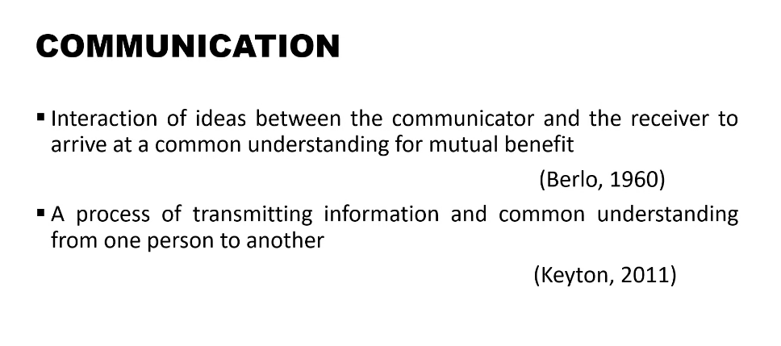

Slide 11
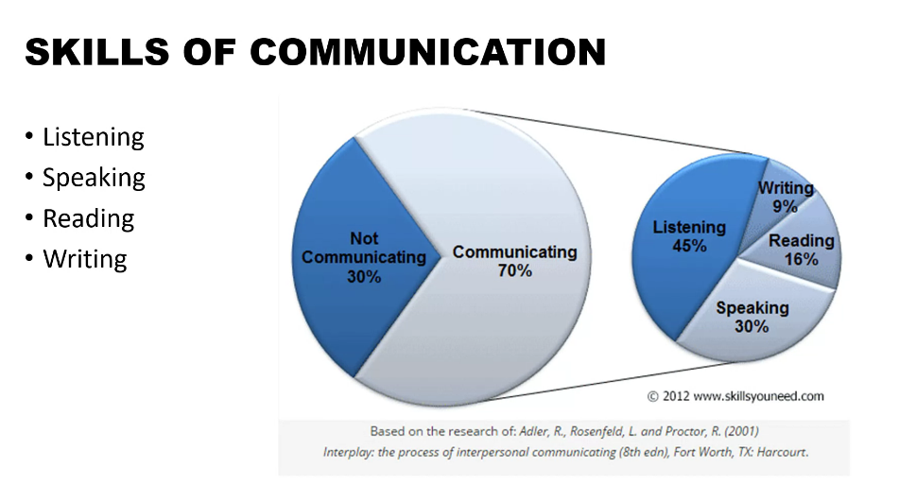

Slide 12
Communication is
A word of Latin origin- ‘communicare’
It means sharing of information or intelligence
To import or to make common
Concerned with business –trade and commerce, medical, legal, and engineering profession
Transmission of scientific and technical information
Includes all the methods, means and media, channels, network and systems of communication
Notes:
Technical communication is the process of conveying technical information through writing, speech, and other mediums to a specific audience. Information is usable if the intended audience can perform an action or make a decision based on it (Johnson-Sheehan 7). Technical communicators often work collaboratively to create products (deliverables) for various media, including paper, video, and the Internet. Deliverables include online help user manuals, technical manuals, specifications, process and procedure manuals, reference cards, training, business papers and reports.
Technical domains can be of any kind, including the soft and hard sciences, high technology including computers and software, consumer electronics, and business processes and practices.

Slide 13
Multidimensional, dynamic and interactive process
Involves the effective transmission of facts ideas, thoughts
A systematic understanding of scientific and technical subjects.
Exchange of facts, ideas, opinion or emotion
Scientific by nature
Specialized writing

Slide 14
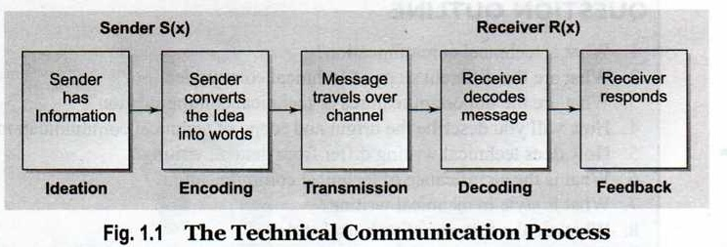
TECHNICAL COMMUNICATION PROCESS-
IT CONSISTS OF FIVE STEPS-

Slide 15
Ideation
The process of ideation depends on the formation of the idea or selection of a message to be communicated. Its scope is determined by-
sender’s knowledge
experiences,
abilities
the purpose of communication
the context of the communicative situation
Contains two type of messages-
Logical messages contain factual information
Emotional messages consist of feelings and emotions

Slide 16
Encoding
This is the process of changing the information into some form of logical and coded message. It involves-
a) Selecting a language for communication
b) Selecting a right medium for communication
c) Selection of appropriate form

Slide 17
Transmission
It refers to the flow of message over the chosen channel. It involves-
Choosing the proper time (when)
Proper place (where)
Proper way (how) to communicate

Slide 18
Decoding-
It involves the interpretation and analysis of the message
Response
It is the action or reaction of the receiver to the message.
It provides a feedback

Slide 19
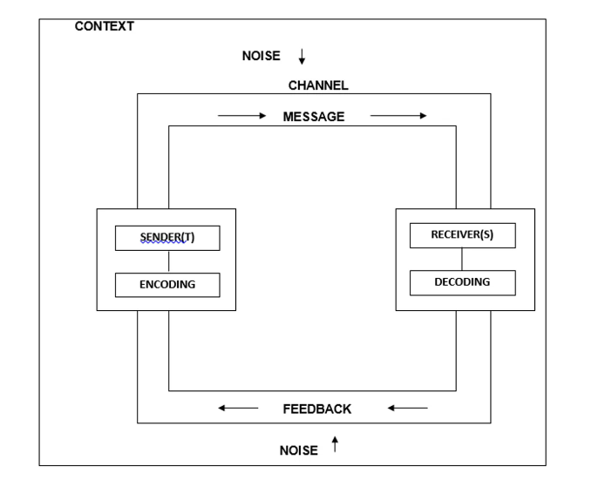

Slide 20
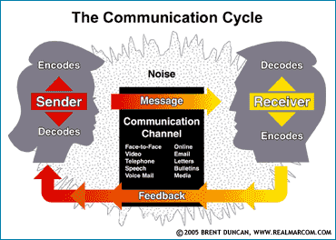

Slide 21
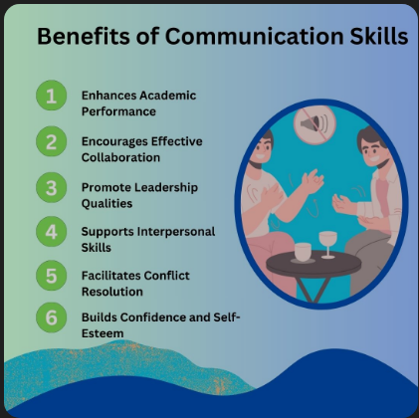

Slide 22
IMPORTANCE OF COMMUNICATION SKILLS
1. Importance of Workplace Communication: Effective communication skills are crucial for fostering strong professional relationships in the workplace.
2. Building Personal Bonds: Communication skills form the foundation of healthy personal relationships, nurturing trust and empathy.
3. Conflict Resolution Through Communication: Communication skills are vital
for resolving conflicts by expressing viewpoints constructively.
4. Communication in Decision Making: Communication skills play a significant role in presenting options and ensuring all voices are heard in decision-making.
5. Communication Skills for Leadership: Leaders rely on communication skills to
articulate vision, motivate teams, and inspire trust.
6. Boosting Self-Expression and Confidence: Mastering communication skills
empowers individuals to express thoughts confidently.

Slide 23

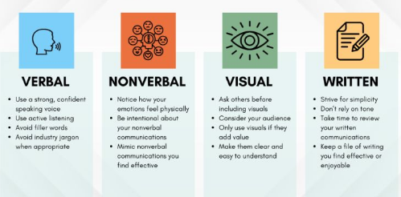

Slide 24




Types of Communication: It is mainly of two types:
Verbal: Verbal Communication means a communication in which words are used to communicate the ideas or thought.
Non-Verbal: It is mainly done by body language or sounds.

Slide 25


Verbal Communication may be further divided into two parts
Oral: In oral communication only spoken words are used. There is no need of paper or stationary in it.
(ii) Written: In written communication paper or stationary is used. It takes time to happen because it moves through proper channels.
Written Communication may be further divided into two parts
(i) Formal: Formal Communication is a communication which needs a specific format or process and formality.
(ii) Informal: Informal Communication does not need any format or channels Format in this communication may be simplified.

Slide 26
Categories of technical communication
External communication -communication between two organizations through letters, external proposals, broachers, information bulletins, instruction manuals etc.
Internal communication -includes memos describing problems or requesting additional resources, different kinds of reports, internal presentations and proposals, company meetings, policy statements, office instructions

Slide 27
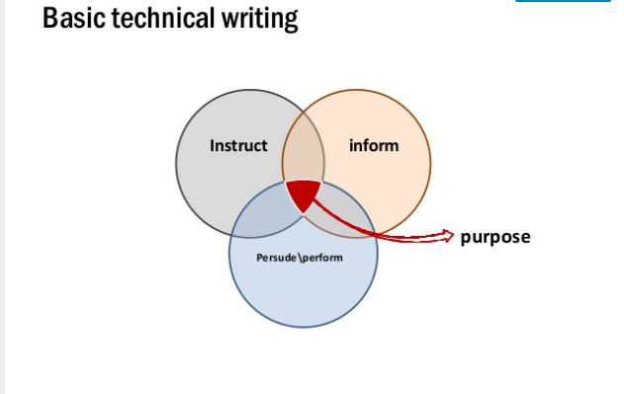

Slide 28
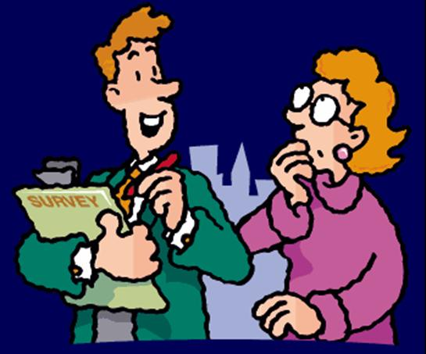
Basic purposes
To Inform

Slide 29
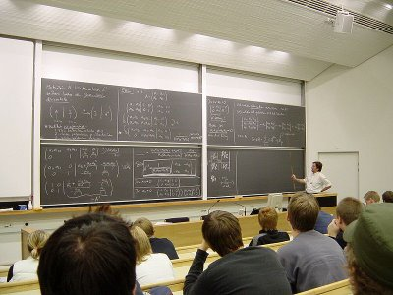
To Instruct

Slide 30
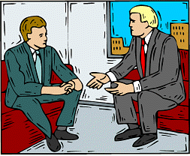
To Persuade

Slide 31
Features of Technical Writing
ACCURACY
Accuracy of information
Accuracy of expression
Facts to be recorded carefully
No errors of grammar
‘Precision' in the use of words
Notes:
ACCURACY- Technical writing needs accuracy of information as well as accuracy of expression. Facts have to be recorded carefully and appropriately. Accuracy of expression demands that there should be no errors of grammar, spelling, punctuation or usage. Accuracy of expression demands 'precision' in the use of words, phrases, sentences and paragraphs.
Check the spelling, punctuation and grammar of your sentences and make sure they are correct. If you use a computer spell checker, be careful. Make sure that you know which word to select. Many easily corrected errors in your written work will affect your presentation and your marks. Sometimes you can see errors more easily if you do not proofread your writing until a day or two after finishing writing. This is called 'the drawer treatment'. The Learning Centre has many resources on punctuation, grammar and spelling that you can use.

Slide 32
BREVITY
Quality of being brief
The minimum number of words
Avoid long sentences
Avoid too many long sentences
Notes:
BREVITY- Brevity is the quality of being brief .One must try to be as brief as possible and give maximum information in the minimum number of words possible.
Avoid too many long sentences. Sentences with four or more clauses, or parts, are confusing to read. Your text will probably read better if you consider making two sentences rather than one long sentence. If you want to include a qualification or an example then a long sentence is usually appropriate.

Slide 33
CLARITY
Be clear
art of making idea clear
clarity of thought
clarity of expression.
Notes:
CLARITY- Clarity contributes to communicative effectiveness. One can not achieve communicative objectives if one is not clear. Clarity is the art of making your idea clear to your audience. Clarity involves both clarity of thought and clarity of expression.
Avoid being unclear and ambiguous. This can happen when you do not specify what you are writing about and can even depend how you use words like 'it', 'this', 'thing', 'way', 'some' etc.

Slide 34
COMPREHENSIVENESS
With all information
All data
Arranged logically
Notes:
COMPREHENSIVENESS-It demands that the document should be complete with all information that readers will need.

Slide 35
OBJECTIVITY
Objective and systematic discussion
Analysis and interpretation of facts
Impersonal presentation of facts.

Slide 36
VERTICAL CHANNEL
DOWNWARD COMMUNICATION
UPWARD CHANNEL
HORIZONTAL COMMUNICATION
DIAGONAL CHANNEL
Notes:
There are three formal channels of communication. Vertical channel can be upward or downward i.e. the flow of information can be from superior to subordinate or from subordinate to the authority. Horizontal flow of communication promotes team work and diagonal flow of communication doesn’t flow any rules.

Slide 37
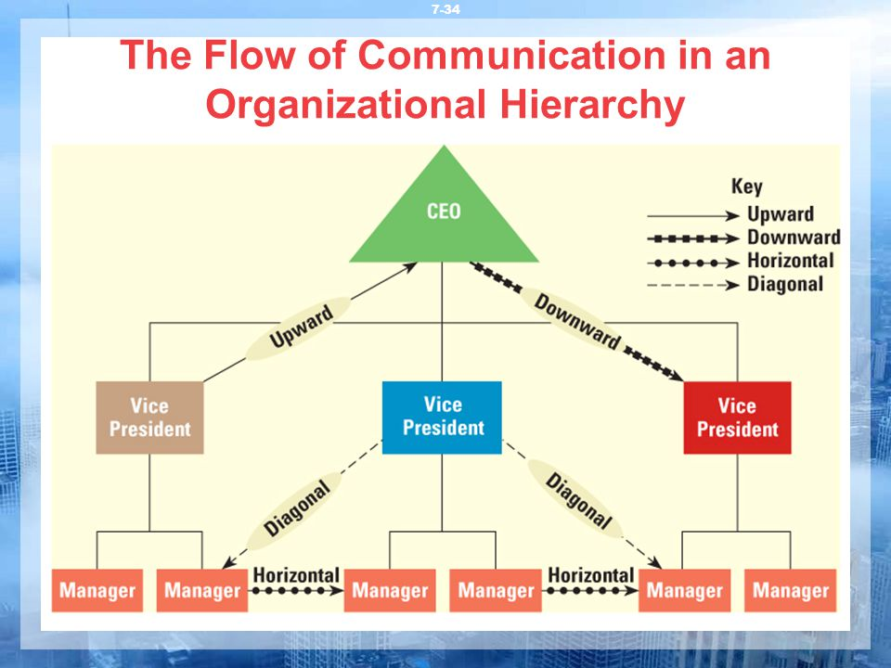

Slide 38
Thanks

